Slide 1


Common-Mode fundamentals for
Shipboard Power Systems
Part 5
Impact of Modulation Method on CM Voltage of power electronics
Dr. Norbert Doerry
Dr. John Amy
http://doerry.org/norbert/MarineElectricalPowerSystems/index.htm
© 2025 by Norbert Doerry and John Amy
This work is licensed via: CC BY 4.0 (https://creativecommons.org/)

Slide 2
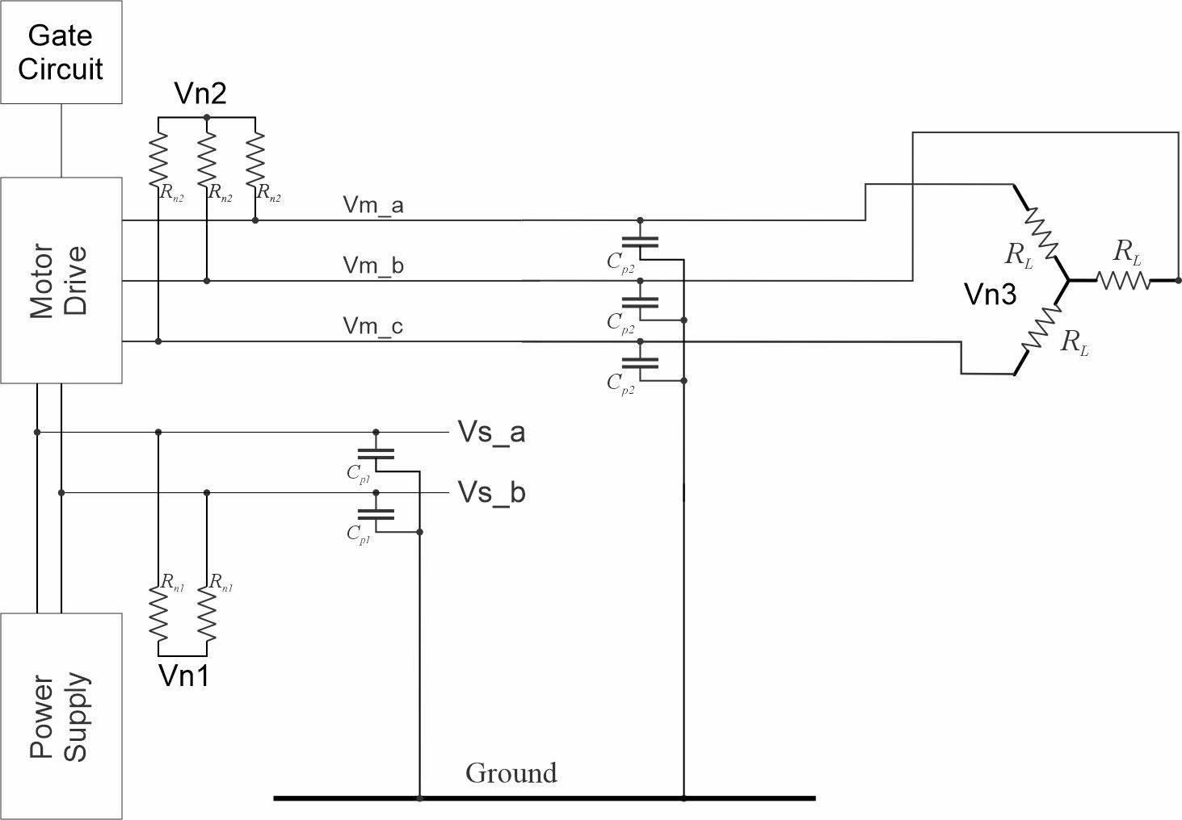
Example Power Electronic Circuit
C_{p1} = 2.2 µF
C_{p2} = 2.2 µF
R_{n1} = 1200 Ω
R_{n2} = 1200 Ω
R_{L} = 300 Ω

Slide 3
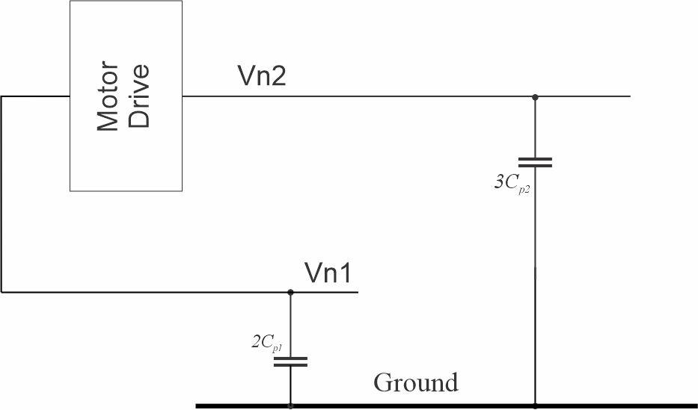
Example Power Electronic Circuit – CM model
2C_{p1} = 4.4 µF
3C_{p2} = 6.6 µF

Slide 4
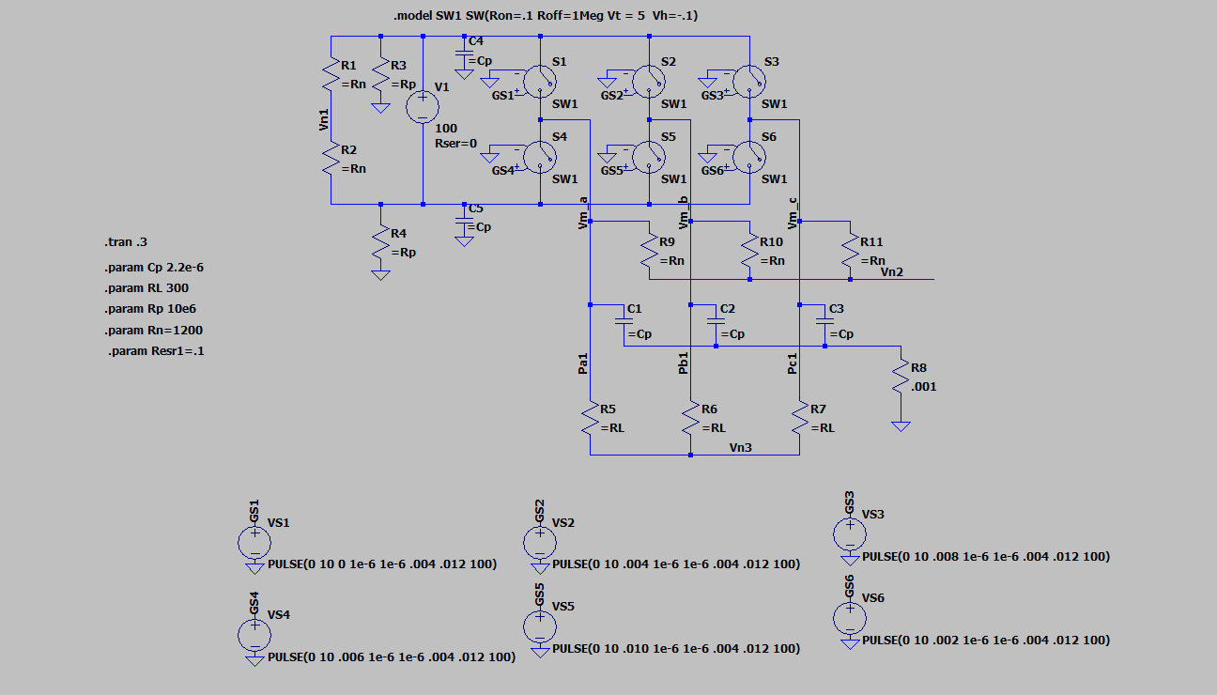
LTSpice Simulation

Slide 5
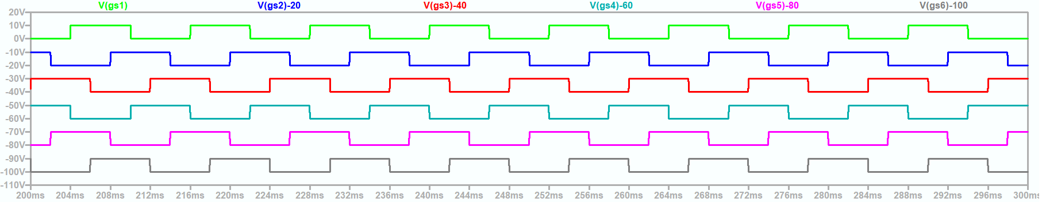
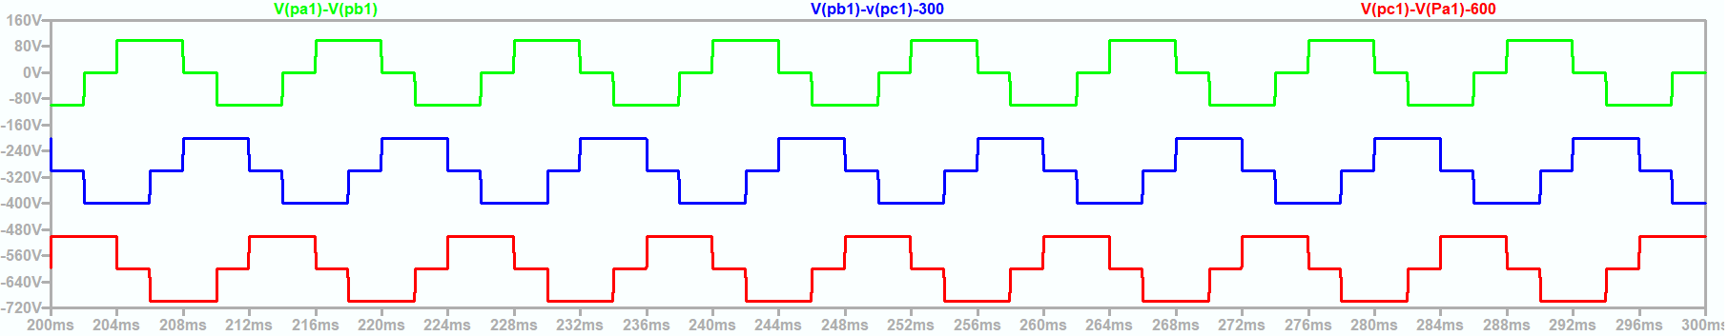
180° Mode modulation scheme
20250406 Inverter CM d.asc

Slide 6
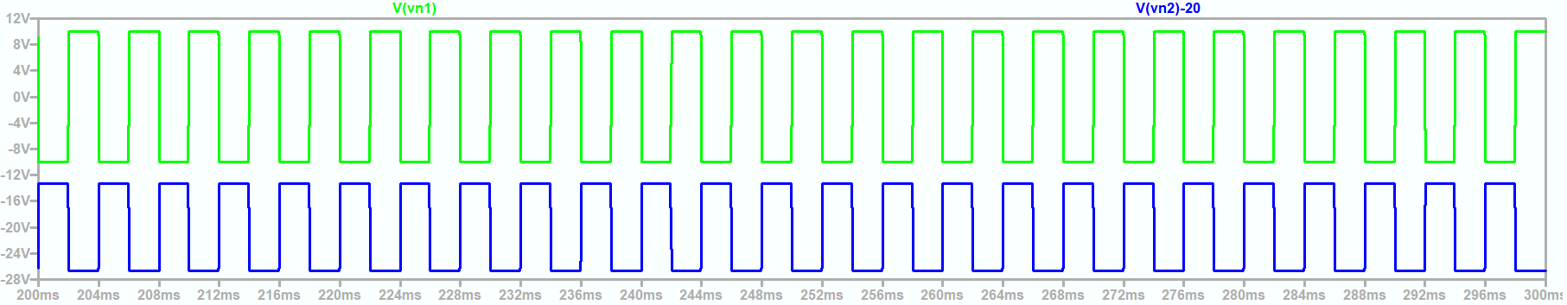
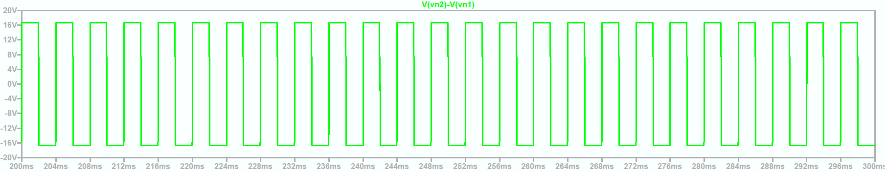
Common Mode Voltages (180 ° Mode)
20250406 Inverter CM d.asc

Slide 7
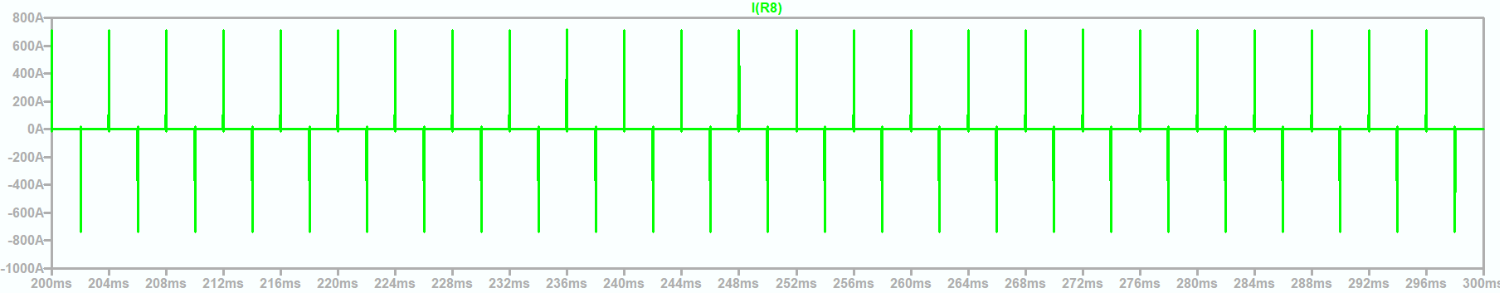
Common Mode Current (180 ° Mode)
20250406 Inverter CM d.asc

Slide 8
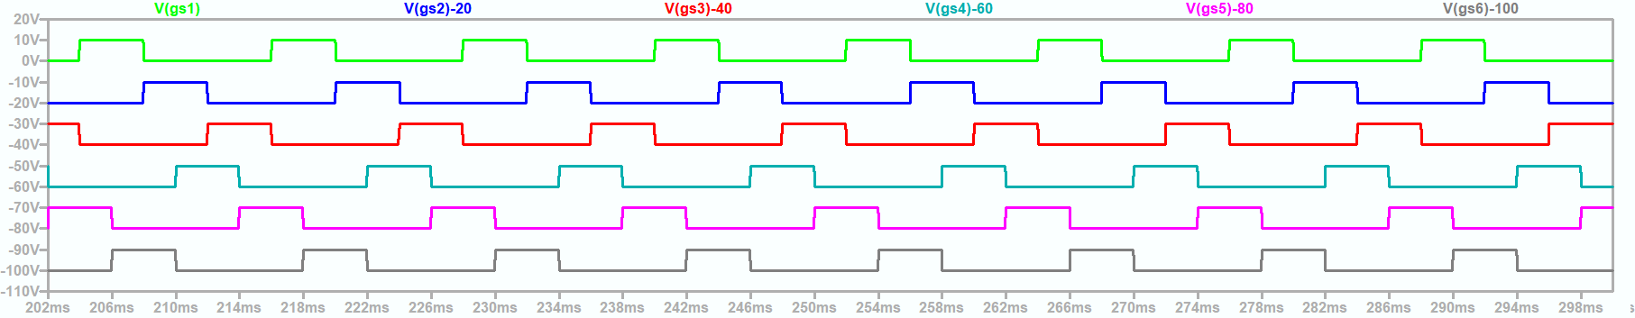
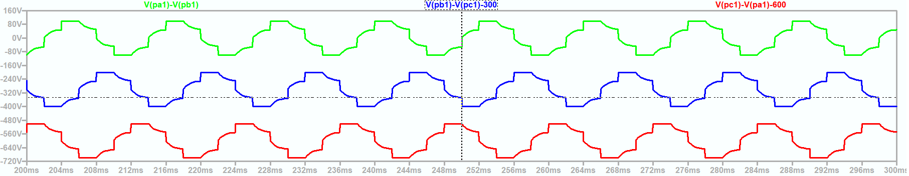
120° Mode modulation scheme
20250406 Inverter CM c.asc

Slide 9
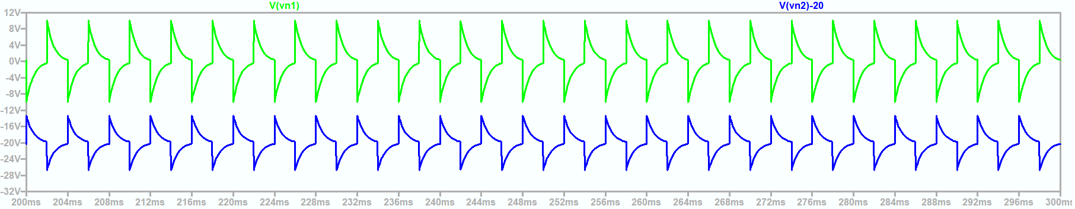
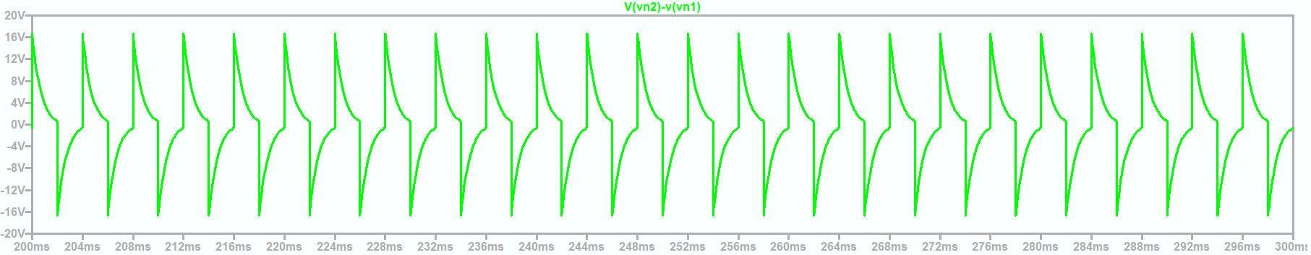
Common Mode Voltages (120 ° Mode)
20250406 Inverter CM c.asc

Slide 10
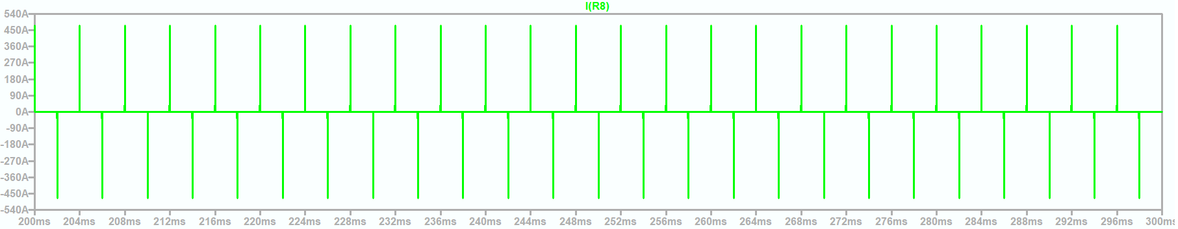
Common Mode Currents (120 ° Mode)
20250406 Inverter CM c.asc

Slide 11
Other Modulation Schemes
P1 mode – Like 180° Mode, but has 1 additional pulse on leading and trailing edges
P2 mode – Like 180° Mode, but has 2 additional pulses on leading and trailing edges
V/f mode – Pulse Width Modulation for sine-wave

Slide 12
Wrap up

